Slide 1

GOLDEN RULES!
These slides were designed for information not presentation, so some are a bit word heavy to avoid a poorly formatted word doc
This is largely a first draft!

Slide 2
To start us off I want to quote the ex-Mental Health Commissioner of NSW when he gave me some training.
“The best way to view mental health is that everyone at any given time is always trying their best to be their best selves”.
He also provided me with the number 1 golden rule (the horse and cart), which Cyndi displayed well in the patient interaction video during the workshop

Slide 3

GOLDEN RULES!
Horse and cart model (most important)
Unmet needs (the source of all escalation/stress)
Threat modelling (we already know this stuff!)
Changes from baseline (side channels!)

Slide 4
THE HORSE AND CART MODEL!
The horse and cart model I use for communication with those experiencing high amounts of distress (this is the trauma informed label of mental health)
Imagine your student is a horse
You are also a horse, but you have a cart
The cart holds all your interventions and tricks!
You notice your student is distressed and want to help
You mention an intervention and are met with resistance (recall during the video with Cyndi she spoke of something relating to the patient’s holiday or something and he instantly withdrew)
She then immediately forgets about the cart and refocussed on just being two horses (focus on the relationship) until his withdrawal and disengagement faded
Eventually continuing with her video, you saw her rebuild rapport until she got the patient to the point of accepting her interventions.
The whole point of this model is to tease and test interventions but immediately withdraw when met with resistance to refocus on the relationship.
SAFETY > RELATIONSHIP > INTERVENTIONS

Slide 5
HORSE AND CART CONT.
What does an intervention look like?
Could be simple redirection
Taking deep breaths
Suggesting escalated care
Suggesting a walk
Getting more information out of them
Even speaking is an intervention
Start small with interventions
Think, the bigger the intervention, the more rapport is needed

Slide 6
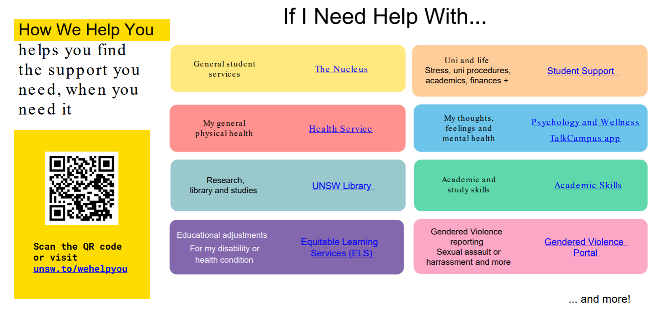
Some interventions Cyndi provided

Slide 7
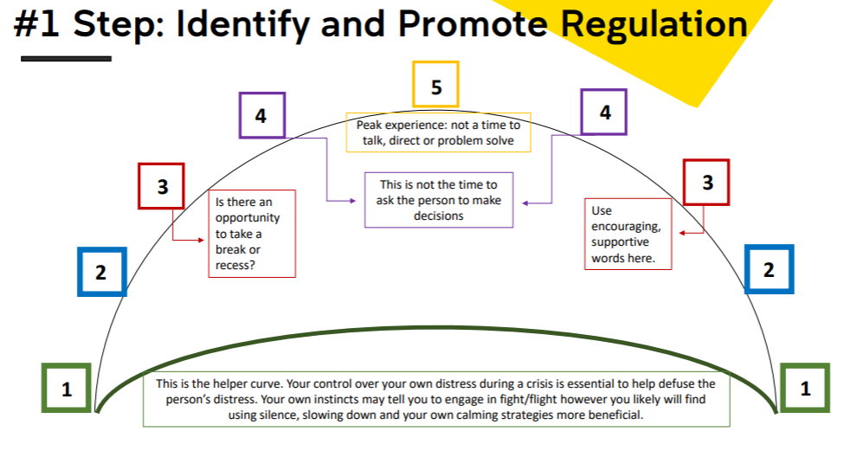
Identifying windows of interventions (From Cyndi)
Remember you yourself, need to be regulated, else you are in no position to regulate someone else.
3-5 is the areas where you should be hesitant to provide interventions and just focus on the relationship

Slide 8
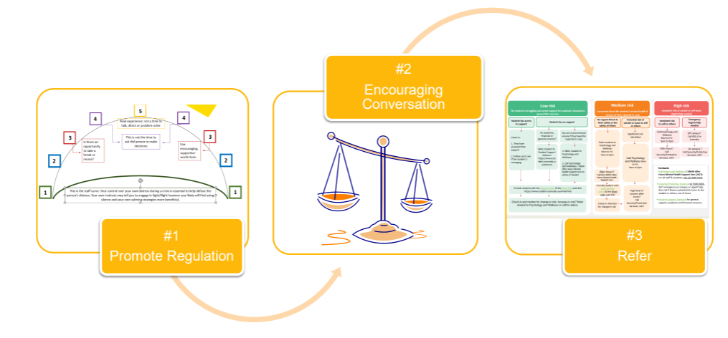
The horse and cart cycle (applied to Cyndi’s resource)
Relationship (Horse)
Interventions (cart)
Relationship (Horse)
Note: some regulation promotion is an intervention (cart)

Slide 9
GOLDEN RULE NUMBER 2 – THE SOURCE OF MOST ESCELATION/STRESS (UNMET NEEDS)
Immediate | Environmental | External | Internal
Is someone bullying, targeting, or excluding them? | Is the environment too noisy, crowded, or chaotic? | Has something happened at home or in their personal life? | Are they in physical pain or discomfort? Are they experiencing emotional pain or distress?
Did something another student or staff member say upset them? | Are there strong smells or sensory irritants? | Family issues (e.g. conflict, loss) | Are they confused or struggling to understand work?
Did they just experience a specific triggering event? (eg embarrassment) | Does the environment make them feel like they won’t get attention or support? | Academic pressure (e.g. exams, expectations, sibling/peer comparison) | Are they not getting attention or support when needed?
Does someone near them have a bothersome smell? | Is there nowhere comfortable to sit or regulate? | Stress about pets, relationships, or personal concerns | Are they dysregulated due to condition (e.g. ADHD, autism, trauma, physical condition)
Escalation is often a response to unmet needs rather than intentional behaviour. Identifying these needs assists with rapport. Examples of stress in the table!

Slide 10
UNMET NEEDS CONT.
When noticing stress/dysregulation/escalation and you begin to engage. Before responding, pause and consider what may be driving the distress.
Some niche student related examples of unmet needs
Not enough sleep
Required items hard to reach (think exams)
Exam room is not well suited for exams (we need to fix this for 1337!!)
Student is expected to know more than the pre-requisite knowledge for a course (e.g. 2521/1521 requires 1511 completed)
A sub point of this is remembering the pre-reqs for a class and that not everyone is at the same stage of coding, a significant number of students suffer inferiority complexes when comparing themselves who have coded prior to uni.
To contextualise this, for almost every other school, students are on the same footing as their scaffolded pre-req knowledge comes from the HSC and classes already completed

Slide 11
UNMET NEEDS CONT.
A subtle unmet need that only healthcare training will provide is psychosocial theory.
In short, most psychosocial theories suggest a few psychosocial goals must be met, challenged and balanced to support progression and functioning.
Following Eriksons model the most common stage we will see is.
Stage 5: Identity vs. Role Confusion (12–18 years): Adolescents explore their independence and develop a sense of self. Success leads to fidelity.
Most people take longer than defined age ranges to develop (thus stress and escalation are more likely)
They are actively developing:
Independence
Sense of identity
Personal values
How they relate to authority (as staff we play a major role in this)
Their professional identities (as staff we play a major role in this)

Slide 12
Our role in psychosocial development
In a classroom
Staff = authority figure
Student = developing identity within that authority structure
This creates natural tension:
Students want autonomy and identity but must operate within rules and expectations
How this effects behaviour
When psychosocial needs are not met, students may respond to authority in different ways (or even develop based off staff example)
Watch out for
Submission/Compliance (agrees quickly, avoids conflict, appears “cooperative”)
Possibly underlying factors are low confidence, fear of negative judgement, desire of approval, uncertainty of identity
Withdrawal / disengagement (shuts down, avoids interaction, minimal responses)
Possible drivers are feeling overwhelmed, feeling misunderstood, fear of embarrassment/failure
Resistance / defiance (challenges authority, argues or refuses, escalates)
Possible drivers are perceived threats to identity, feeling controlled or disrespected, need to assert independence
IDENTITY CHALLENGE + AUTHORITY PRESSURE = ESCELATION
As we are authority figures, every interaction with a student contributes to their identity. Which will either reinforce confidence or reinforce doubt
This is no different to healthcare and patient interaction.
We must be mindful of how we present our professionalism, how we apply authority, and what models we reinforce.
Because students are not just learning content, they are learning how respond to authority, how to see themselves, how to behave under pressure, and how their authority figures do the same.

Slide 13
GOLDEN RULE NUMBER 3 – THREAT MODEL!
A link between cyber security and healthcare is threat modelling / the clinical reasoning cycle!
In healthcare we order ACTUAL and POTENTIAL risks by level of impact
E.g. A student/patient complains of chest pain.
Rule out life threatening causes (threat = possible heart attack)
Mitigation/testing: ECG + blood tests + strong pain killer + aspirin
Consider other serious causes (threat = lung issues)
Mitigation/testing: Chest x-ray (checks heart and lungs)
Lower risk possibilities (threat = gastric causes)
Mitigation/testing = Trial treatments (antacids) and watch response
Once all major risks ruled out
Threat = consider anxiety / panic response
Mitigation = anti-anxiety medication
Consider potential risks (including worst-case scenarios) without making assumptions, update your understanding as new information is gained.
We do NOT assume the cause, we progressively rule out risk, we work from highest > lowest risk
CONSIDER RISKS > PRIORITISE IMPACT > UPDATE UNDERSTANDING WITH NEW INFO
ANOTHER REMINDER: IMMINENT HARM TO SELF/OTHERS OVERRIDES ALL OTHER CONSIDERATIONS

Slide 14
GOLDEN RULE 4 – SIDE CHANNELS (CHANGE FROM BASELINE BEHAVIOUR)
If a student is normally poorly groomed and dishevelled (like myself) it does not mean I am unwell. This is my baseline.
Remember Locard’s Exchange Principle
“every contact leaves a trace”
Behaviour is data, not a diagnosis
SIDE CHANNELS DO NOT CONFIRM CAUSE OR DISTRESS
NOTICE CHANGE > STAY CURIOUS > DO NOT ASSUME > ADJUST RESPONSE

Slide 15
Appearance side channels!
Change in grooming/dishevelled appearance
A strong trauma informed question can be “Cool shirt, I haven’t seen that one before, does it have a special meaning to you”?
You may find out that it has no meaning or the meaning is no indication of changed state (eg. Every 4 weeks I lose a bet and must dress like this/I ran out of clean clothes – which can be another side channel!)
But you may also strike gold “this shirt makes me feel happy”
Avoid: “you usually dress so well”
Wearing long sleeved clothing on warm days (or wearing clothing that is inappropriate to climate/culture/setting).
Eg. Long sleeves/jumper on a warm day
May indicate underlying concerns (eg concealment of injuries/self harm)
Consider:
Use of ‘blood thinners’ (bruise easily)
Anaemic (bruise and bleed easily)
A change in appearance is an invitation to be curious not a diagnosis

Slide 16
Behavioural side channels
Behaviour includes
How a student is sitting or positioned (e.g. My baseline is I always slouch so don’t be afraid to call me out if I am suddenly sitting straight, even if the assumption is I am trying to correct posture)
How a student interacts with staff and peers
How they engage with tasks and expectations
What to look out for
Cooperation/politeness -> resistance or refusal
Engaged -> withdrawal or avoidance
Calm -> restless, agitated, avoidance
Consistent effort -> sudden disengagement
Positioning
Posture (eg if usually slumped, rigid, unusually still)
Movement (restlessness, pacing, fidgeting/stimming – normal for ADHD/Autism but be mindful of increased fidgeting/stimming)
Positioning (turning away, avoiding interaction)
Behaviour is communication, especially when a student is unable to use words
Students don’t just change behaviour, behaviour is an adaption to how they experience a situation
NOTICE CHANGE > CONSIDER CONTEXT > DO NOT ASSUME > ADJUST RESPONSE

Slide 17
Speech side channels
What to look for (changes in how a student normally communicates)
Sudden increase/decrease in talking
Change in tone, pace, or volume
Speech becoming
More abrupt
Less coherent
Unusually quiet or loud
Pressured (rapid, hard to interpret)
Note: Computer science environments have higher prevalence neurodivergent and introverted students, what matters is CHANGE FROM BASELINE
Examples of change
Normally quiet -> suddenly talkative or reactive
Normally engaged -> minimal or one-word responses
Normally structured -> disorganised or fragmented speech
Normally direct -> unusually defensive or withdrawn
Trauma-informed approach
Use supportive, non-threatening language
“You seem bit quieter than usual, how are you going?”
“Want me to walk through that again?”
Avoid
Forcing interaction
Interrupting or talking over
Interpreting tone as attitude
Insights
Silence != disengagement
Direct communication != disrespect
Changes in communication = IMPORTANT DATA

Slide 18
A quick note on neurodivergence baseline
Neurodivergence can include
ADHD
Autism
Anxiety-related conditions
Other differences in communication and processing
Many students will have non-typical communication and behaviour patterns
Difference does not mean distress
A student may
Prefer minimal interaction
Communicate very loudly
Avoid eye contact
Appear withdrawn
Have poor control over their pitch
This brings us to masking (next slide)

Slide 19
Neurodivergence and masking
What is masking
Masking is un/consciously hiding difficulties (or symptoms)
An attempt to imitate “typical” behaviour
Tries to meet perceived expectations
Is one of the dominant features of autism (but not restricted to autism)
Why this matters
Students may appear calm, engaged, or “fine”
Some students are not calm, they are coping
Still experience significant stress or overload
Suddenly disengaged or escalate after prolonged effort
Common pattern
CAPACITY OVERLOAD > MASK DROPS > BEHAVIOUR CHANGES
A very difficult nuance to be mindful of
Dropping the mask is self-regulation which will appear as significant change to baseline for us but may be a very healthy thing for the student as it is a release of sustained effort!
What to look out for as staff
Loss of capacity, exhaustion, reduced ability to maintain “normal”
This is not
Attitude, intentional disruption

Slide 20
Mood and affect side channels
Mood = the person’s stated feeling (asking how are you when a student enters the room is the easiest way to assess baseline!)
Affect = how their mood appears to us
E.g. Say a student says “I am happy” but is also crying or frowning the affect we see is the crying and frowning!
We look for
Facial expression
Body language
Tone and behaviour
What to look out for?
When mood is incongruent with affect
When mood is negative or low (compared to baseline)
Some special edge cases
Depression/Autism/Neurological conditions– usually a non-reactive affect with minimal body language cues
Schizophrenia - Can have a mask like affect (as if they are wearing a mask permanently)
Reduced expression != absence of feeling
A real difficulty with mood and affect
Almost always people will reply with a positive mood word (happy, great, fine etc) unless in a psychological setting (office, mental ward etc) but even then, people naturally don’t want to disclose negative mood
Trust what you observe, but always explore with curiosity

Slide 21
Thought form/process side channels
What is thought form?
How people articulate themselves are they (bolded is the ‘most common’ baseline for those not experiencing high amount of distress)
logical/illogical
Coherent/incoherent
Linear/fragmented
Tangential (advanced) - jumping between ideas with little or no logical connection
Circumstantial (advanced) - overly detailed but eventually reaches a single point
What is thought content?
The words and themes they express verbally (themes, ideas, concerns)
Things to look out for
Thoughts of self harm, suicide ideation, or harm to others – IMMEDIATE ESCELATION
Rumination (repeated themes/difficulty moving away from topic – be mindful ADHD/Autism this can be normal – focus on change or intensity)
Delusional thinking (advanced) - fixed false beliefs – this is advanced as you need to completely remove your own bias when assessing this AND consider context – eg my sports team is better than yours, or people who enjoy conspiracy theories, or perhaps you don’t know the topic but believe you do and assume they have a fixed belief
Unusual belief != delusion (the danger is not unusual thinking it is misinterpreting it)
Future thinking (eg “I am going to a concert in a month really excited for it”)
No future thinking is a strong side channel as imagining your wonderful future is a strong protective factor and may indicate reduced hope, low mood, or disengagement
Compare congruency of thought form/content with affect/mood/behaviour (advanced)!

Slide 22
Perception side channels (advanced)
In the context of high distress/mental health perception largely refers to hallucinations and pseudo-hallucinations
We officially call this (so as to not misinterpret) in our notes if the student/patient does not directly disclose “responding to unseen stimuli”
This can be completely normal to a student's baseline. I talk to myself all the time!
Things you may notice
Talking to themselves or appearing to converse with someone else
Stange movements
Anything else I mention is super advanced, so I won’t!
Red flag
If a student discloses that they are experiencing auditory hallucinations that are commanding in nature IMMEDIATE ESCELATION
Command hallucinations may
Put the student at risk of self-harm
Cause significant distress or loss of control
Important clarification
Scenarios involving harm to others are EXTREMELY RARE
Most risk relates to distress, loss of control, or desire to escape the experience
Critical nuance
Affect may appear neutral or even appropriate to situation
Behaviour does not always reflect internal experience
DO NOT ASSUME CAUSE, IMPACT, OR EFFECT

Slide 23
Cognition side channels
Look for
Alertedness (are they alert, awake, engaged, responsive?)
Orientation (ability to understand their environment)
Do they know where they are?
Do they know the current date and time or even season as I often don’t know the date!
Do they know the people around them who should be familiar (e.g. even the builders outside of seclab should be identifiable as construction workers)
Distractibility (note lots of conditions like ADHD/autism being distractible is baseline)
Short/immediate/long term memory loss
Any change in cognition from baseline is a strong side channel

Slide 24
Judgement and insight side channels (advanced)
This is just informational but good to know
Judgement (decision making) and insight (self-awareness) help us understand
How a student makes decisions
How aware they are of their situation
Simple examples of poor judgement are
A student is engaging in unnecessarily risky behaviour (e.g. harming themselves, harm others, negatively impact their future or opportunities)
Simple insight is
How much insight does the student have into their situation?
How much insight do you have into the student?
How much insight do you have into what the student is experiencing?
There is no shame in asking for help or even asking a student for clarity
JUDGEMENT AND INSIGHT CAN CHANGE UNDER STRESS, SUPPORT THE STUDENT, DO NOT LABLE THEM

Slide 25
Eye side channels (simple but complex)
Eyes are simple to observe, complex to interpret so I separated this section from behaviour.
Eye contact patterns
Intense/fixed – possible confrontation or heightened alertness
Avoidance – discomfort, overwhelm or stress
Scanning/darting – hypervigilance, searching environment (student may not feel safe)
Pupil size
Larger – stress, escalation, increased arousal, medication/drug use
Smaller – fatigue, calm state, medication/drug use
Focus and tracking
Difficulty maintaining eye contact
Delayed or unfocussed tracking
Looking past rather than at you
“Glazed” or unfocussed eyes – appearing distant or disconnected
Tearful / Watery eyes – visible or subtle glossy eyes
Red eyes – can be increased blood pressure (which will increase natural stress response), drugs, tiredness
Blink rate
Rapid – stress, anxiety, overload
Reduced – intense focus, distress, or shut down
As always MANY OF THESE BEHAVIOURS CAN BE BASELINE – CHANGE is what matters
Some practical responses
Scanning / hypervigilance -> increase reassurance / offer a safe place to sit
Glazed / unfocussed -> simplify communication
Rapid blinking / overload -> slow pace, reduce pressure
Fixed or intense gaze (Advanced due to potential baseline) -> reduce confrontation, soften approach (but be mindful this intervention may escalate rather than de-escelate if its baseline)
Avoidance of eye contact -> do not force interaction
Eyes give clues about state and capacity, not intent
What eyes show is how hard the brain is working, not how the student feels about you

Slide 26
A few special mention side channels
These side channels are all considered emergencies and you should escalate immediately
Psychiatric emergencies that require IMMEDIATE PSYCHIATRIC ESCELATION
thoughts of self harm
harm to others
suicide ideation
command hallucinations (disclosed)
Serious risk of safety and wellbeing
Medical / Physical Emergencies (these do not discriminate among age groups)
Chest pain (student disclosed)
treat as a medical emergency
do not assume panic/anxiety
If a student discloses heart/chest pain IMMEDIATE MEDICAL ESCELATION REQUIRED
Panic attacks can mimic heart attack symptoms
EG. “Fear of impending doom” (thinking you will die)
You are not expected to differentiate - ESCELATE
You may notice a student is constantly holding his upper left chest and in pain/distress/breathing strangely or with extra effort
Facial droop (maybe half the face can smile other cant) or can’t wave or raise arms, sudden coordination changes (like balance and walking) -> potential stroke -> IMMEDIATE MEDICAL ESCELATION

Slide 27
Responding to emergency side channels
Students may appear calm, minimise symptoms, or avoid seeking help
As staff we need to
Remain calm
Remember our horse and cart
Avoid panic/diagnostic talk/assumptions
Remain with the student
If situation requires immediate external response (e.g. medical emergency), follow UNSW escalation protocols
A special reminder: Be aware that international students are not covered by Medicare, their student fees are high, and a student visa only allows 25 hours of work a week during semester
This may lead to under-reporting symptoms
Reluctance to escalate
Minimisation of serious issues
If the risk is high and uncertain. ACT FIRST CONFIRM LATER
YOU ARE NOT EXPECTED TO BE RIGHT, YOU ARE EXPECTED TO KEEP PEOPLE SAFE
Acting on a false positive is much safer than not acting on a false negative

Slide 28
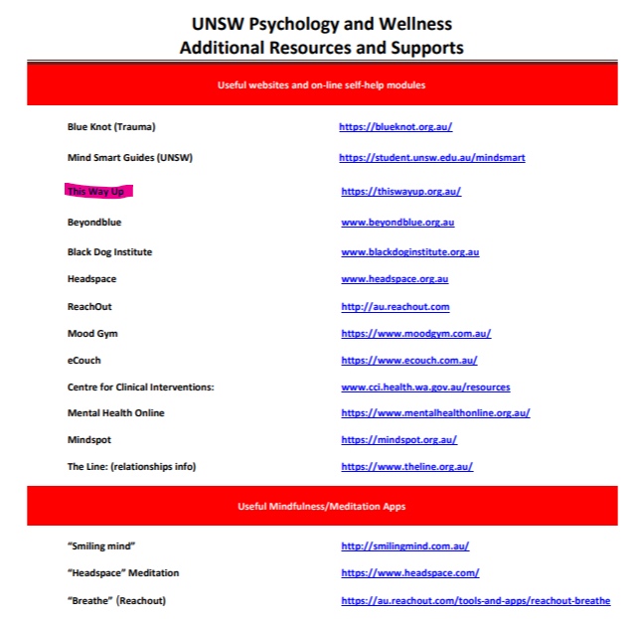
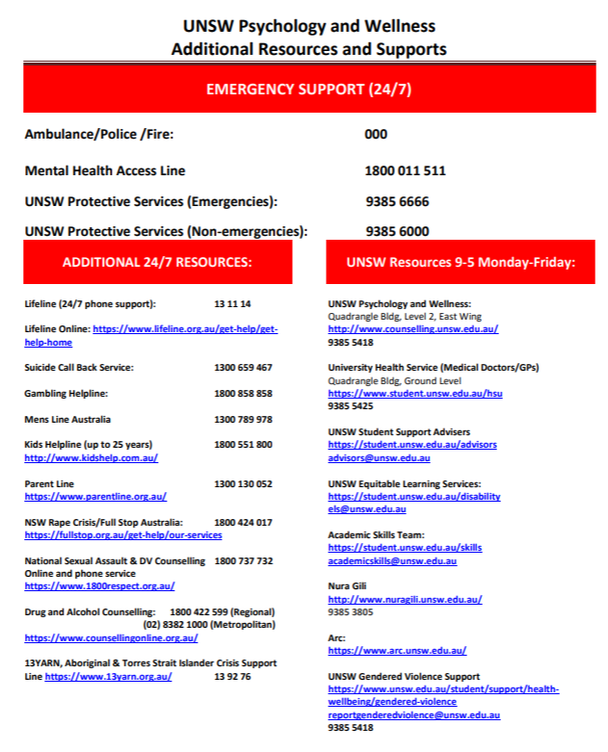
Some escalation services Cyndi provided, with a special mention of this way up

